Slide 1
WordMasters Basics:
10 Easy Steps

Slide 2
WordMasters Basics
You have tremendous flexibility in how you build your team and incorporate WordMasters into your school setting.
  Some schools have the whole class participate while other teams are comprised solely of interested students or those in an accelerated language arts program.
  Others offer it as an after-school enrichment opportunity. Some teams prepare during class while others meet after school or study at home.
  Some small schools and those who homeschool combine grades to create a team.
  The right way is the one that works best for you and your students.

Slide 3
Step 1: Plan Your Calendar
The Challenge Schedule for each meet can be found on the WordMasters website under the RESOURCES tab.
Plan your team’s schedule according to the following:
  Word List availability
  Challenge Test availability
  Score Reporting deadlines
  Results availability

Slide 4

Challenge
Schedule
Important Dates for the 2022-2023 WordMasters Challenge™
Online Enrollment Begins: April 1st
Enrollment Deadline: October 1st *
  *You can still register your team(s) after October 1st. However, we strongly encourage
  you to complete your registration as soon as possible to maximize the length of time
  your students have to prepare for Challenge Meet #1.
Challenge Meet #1 Word Lists Available Online | 10/1/23
Challenge Meet #1 Tests Available Online | 11/4/22
Challenge Meet #1 Tests Administered | 11/7/22 - 11/25/22
Challenge Meet #1 Score Reporting Deadline | 12/02/22
Challenge Meet #1 Results Available | 12/16/22
Challenge Meet #2 Word Lists Available Online | 12/5/22
Challenge Meet #2 Tests Available Online | 1/27/23
Challenge Meet #2 Tests Administered | 1/30/23 - 2/17/23
Challenge Meet #2 Score Reporting Deadline | 2/24/23
Challenge Meet #2 Results Available | 3/10/23
Challenge Meet #3 Word Lists Available Online | 2/27/23
Challenge Meet #3 Tests Available Online | 3/31/23
Challenge Meet #3 Tests Administered | 4/3/23 - 4/1/23
Challenge Meet #3 Score Reporting Deadline | 4/28/23
Challenge Meet #3 Results Available | 5/5/23
Cumulative Champions Announced | 5/5/23

Slide 5
Step 2: Practice Analogy Solving
WordMasters Analogies 101 Plus
  Each of our eleven Analogies 101 Plus sets contains 30 analogies that illustrate various forms of analogical reasoning. Every set uses simple vocabulary suitable for all grade levels (3-8). An answer key is included with detailed rationale for both correct and incorrect answer choices.
  Analogies 101 Plus sets can be purchased online and are delivered as PDF files. You can also access a Google Forms version of the set if desired.
WordMasters Study Tool: Analogy Practice
    A free download titled Analogy Practice (from “Teacher Tools” under the RESOURCES tab) has students build their own analogies to better understand how to solve them.

Slide 6
Analogies101Set A

Slide 7
Analogies 101
Set A

Slide 8
Analogies 101
Set A

Slide 9
Analogies 101
Set A

Slide 10
Step 3: Download Meet #1 Words
To set up your team’s information and download Word Lists for each meet:
Login to your WordMasters account
Select “Manage Teams & Students” from your Dashboard
Assign a Team Leader with contact information for each team
Add students to your team
Select “Download Materials” from your Dashboard
Download the Word List for each enrolled team
Distribute copies to your students
The online Challenge Schedule lists the dates Word Lists are available for each meet.

Slide 11

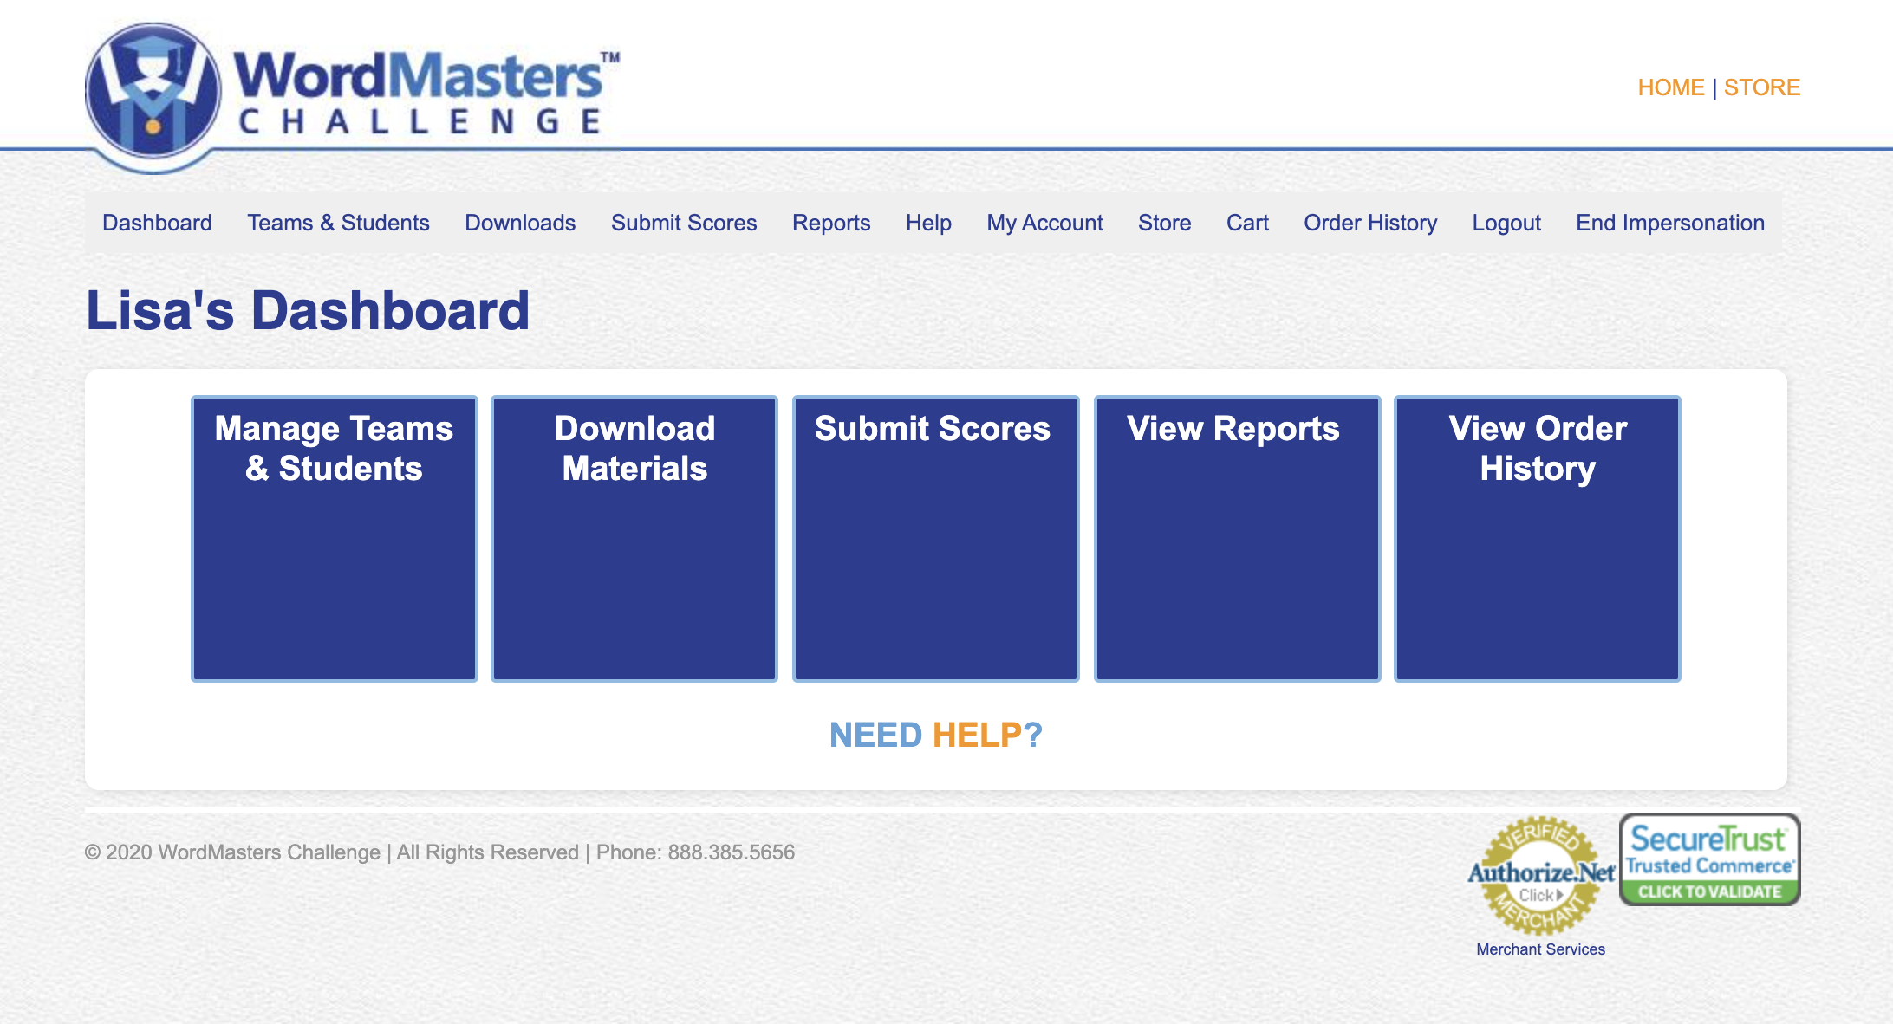
User Dashboard

Slide 12
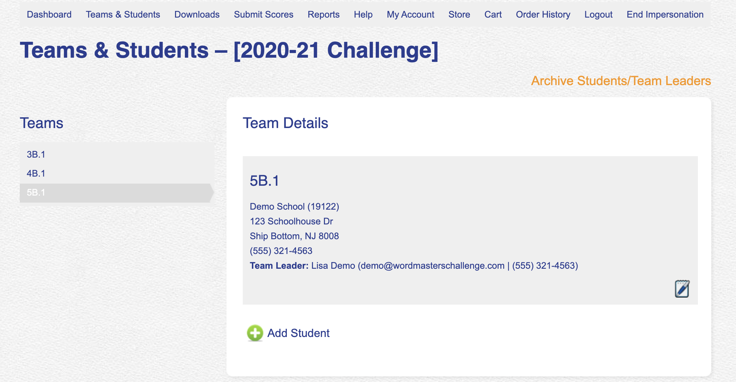
Manage Teams & Students

Slide 13
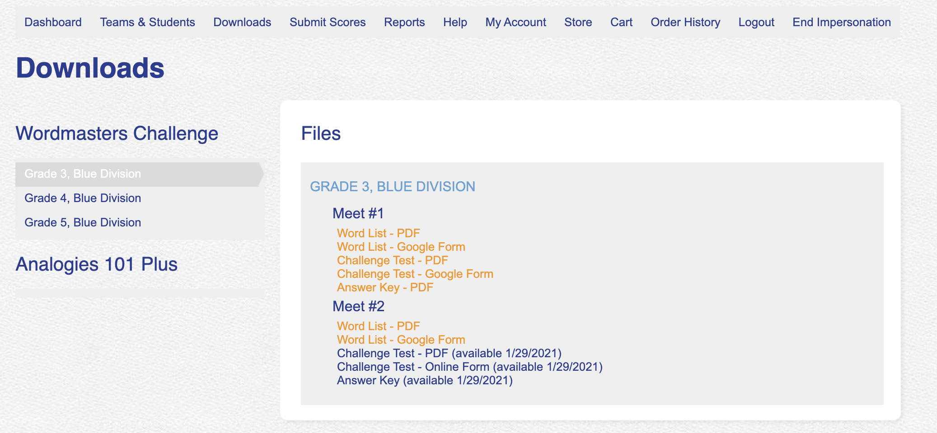
Download Materials

Slide 14
Grade 6/
Blue
Word List

Slide 15
Step 4: Prepare for Challenge Test
WordMasters Study Tools
  Free printable documents for learning tools and games to help students practice their words for each meet.
  PDF files are found in “Teacher Tools” under the RESOURCES tab.
WordMasters Idea Gallery
  Classroom strategies and teaching tools submitted by Team Leaders. Look for them under the RESOURCES tab.
  Don’t forget to share your ideas, too!

Slide 16
Step 5: Download Meet #1 Test
To access your Challenge Tests for each meet:
  Login to your WordMasters account
  Select “Download Materials” from your Dashboard
  Download the Meet #1 Challenge Test and corresponding answer key for each registered team
Each Challenge Test consists of 20 analogies.
  The suggested testing time is 20 minutes.
  However, a strict time limit is not imposed.

Slide 17
Grade 6/Blue Challenge Test

Slide 18
Grade 6/Blue Challenge Test

Slide 19
Step 6: Submit Scores Online
To submit your team’s scores for each meet:
  Download the answer key from your Dashboard
  Score Challenge Tests
  Select “Submit Scores” from your Dashboard
  Enter student scores (no limit). You can create student records at anytime prior to the Challenge Meet in “Manage Teams & Students”
  The system will automatically calculate your team score (sum of top 10 individual scores)
  Since the online system is calculating the team score, test results must be reported by the deadline to be included in the competition results!

Slide 20
Step 7: Acknowledge Individual & Team Results
Check website postings after each meet for:
    Top teams in each division
    Students with perfect scores
    Overall statistics related to meet results
Acknowledge students for their hard work and outstanding achievements. Challenge Tests are difficult! They should feel proud of their efforts.
We will draft a press release for every school with a team placing within the top ten of their division and/or a student receiving a perfect score.
You can write your own press release! Find a template you can customize under “Teacher Tools” to share with your local media and school communications.

Slide 21
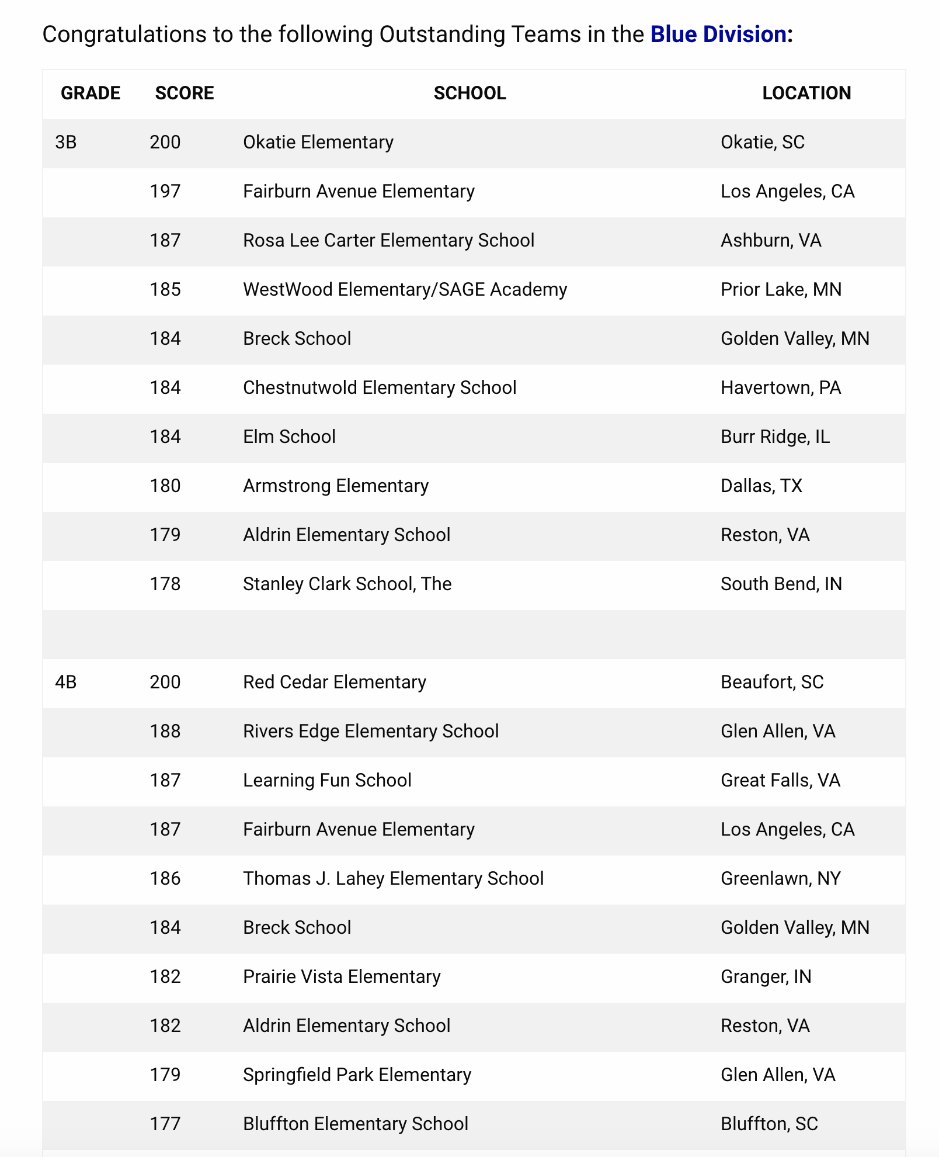
Meet #1
Results

Slide 22
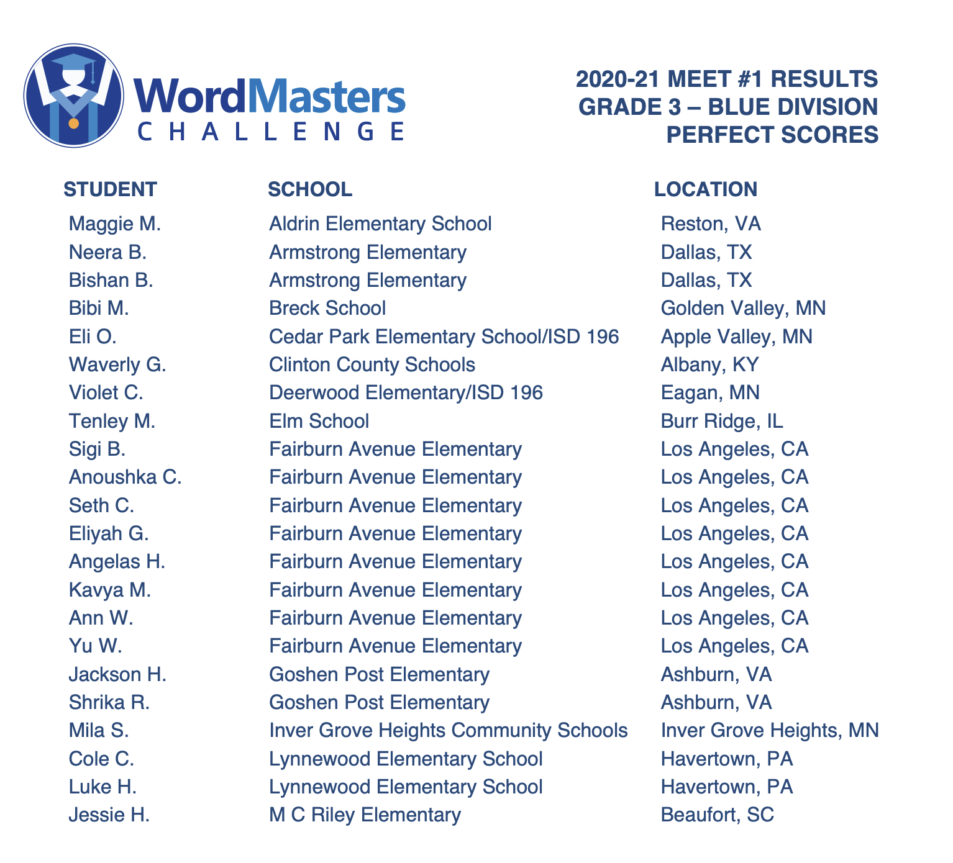
Perfect
Scores

Slide 23
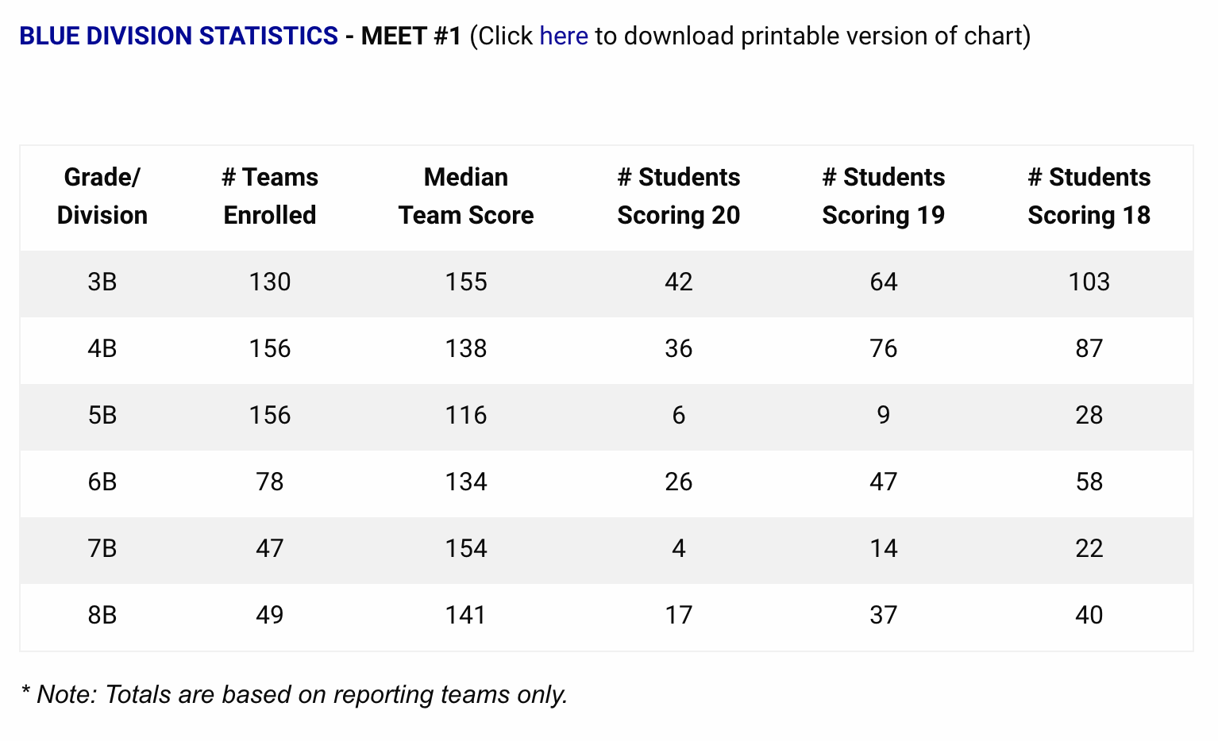
Statistics
Chart

Slide 24
Step 8: Repeat for Meets #2 and #3
Repeat Steps 3-7 for each remaining Challenge Meet:
  Download Word Lists and Challenge Tests when available
  Submit scores prior to the Score Reporting Deadline
Each successive meet will be somewhat more difficult than the one before it. The analogies in Meet # will feature words from each of the first two Word Lists (50 words); Meet #3’s analogies will be based on all three Word Lists (75 words). Students should therefore save all their Word Lists and study materials.

Slide 25
Step 9: Celebrate Cumulative Results
After Meet #3, the system will automatically calculate cumulative individual and team scores.
Check web postings to see if any of your students qualified for national recognition or if your team ranked among the top ten teams per division.

Slide 26
Step 10: Distribute Team Awards
Before Meet #3, we will mail the following for each enrolled team:
  1 Champion Medal-presented to the student of your choice (top scorer, most improved, best team player, etc). It’s up to you.
  10 Team Certificates to present to team members
Extra medals, certificates and other WordMasters items (pencils, pens and markers) can be purchased online to recognize additional team members.

Slide 27
Re-enroll for the next WordMasters Challenge!
Enrollment opens each spring for the following school year.
Enroll before Word Lists are available October 1st.

Slide 28
www.wordmasterschallenge.com | 888.385.5656

